Slide 1









Analytics for Unstructured Data MSBA, Fall 2021 September 9
Dr. Anitesh Barua
David Bruton Jr. Centennial Chair Professor in Business
Distinguished Fellow, INFORMS Information Systems Society
University of Texas Distinguished Teaching Professor
Associate Director, Center for Research in e-Commerce
McCombs School of Business, University of Texas at Austin
Email: aniteshb@gmail.com

Slide 2
Dealing with Text
From a stream of characters to tokens
Sentence and word-level tokenization with nltk
E.g., 'Hello Mr. Smith, how are you doing today?', 'The weather is great, and Python is awesome.', 'The sky is pinkish-blue.', "You shouldn't eat so many cookies.“
from nltk.tokenize import sent_tokenize, word_tokenize
TEXT = "Hello Mr. Smith, how are you doing today? The weather is great, and Python is awesome. The sky is pinkish-blue. You shouldn't eat so many cookies."
print(sent_tokenize(TEXT))
print(word_tokenize(TEXT))
* https://pythonprogramming.net/tokenizing-words-sentences-nltk-tutorial/ for tokenization

Slide 3
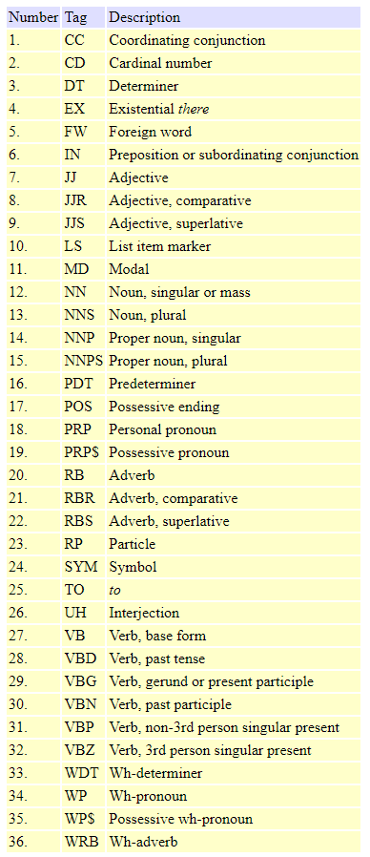
Part-of-speech
https://www.ling.upenn.edu/courses/Fall_2003/ling001/penn_treebank_pos.html

Slide 4
Tagging Tokens
Parts-of-speech (POS) tagging
import nltk
from nltk.tokenize import word_tokenize
text=word_tokenize(“And now for something completely different”)
print(nltk.pos_tag(text))
* Need to install numpy for pos_tag: http://sourceforge.net/projects/numpy/files/

Slide 5
Unigrams Vs. Bi- or Trigrams
Sometimes bigrams may be more meaningful than unigrams
import nltk
from nltk import word_tokenize
from nltk.util import ngrams
from collections import Counter
text = "This camera produces awesome pictures."
token = nltk.word_tokenize(text)
bigrams = ngrams(token,2)
trigrams = ngrams(token,3)
print(Counter(bigrams))
What about POS bigrams? When would they be useful?
Notes:
Ngrams are n consecutive words in a sentence

Slide 6
Stemming & Lemmatization
Reducing the size of the vocabulary in a doc collection
Different forms (inflections) of a word (e.g., organize, organizes, organized and organizing)
Families of derivationally related words with similar meanings: E.g., democratic, democratization.*
Stemming: “The process for reducing inflected (or sometimes derived) words to their stem…” ⁺
A heuristic process that chops off the ends of words.
Operates on single words without knowledge of context
Check out http://textanalysisonline.com/nltk-porter-stemmer
*Stanford NLP Group, ⁺Wikipedia
Notes:
Porter Stemmer

Slide 7
Lemmatization
“The process of grouping together the different inflected forms of a word so they can be analyzed as a single item.”
Lemma = root or base word
E.g., 'walk', 'walked', 'walks', 'walking‘ -> walk
More complex than stemming: Requires understanding of context, determining the part of speech, etc.
E.g., lemmatize ‘is’ or ‘are’ as verbs
Check out http://textanalysisonline.com/spacy-word-lemmatize
Notes:
Stemmer is way faster then Lemmatisation

Slide 8
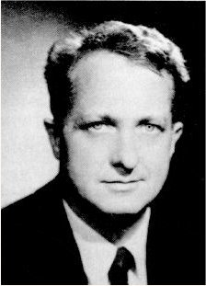
Linking Occurrence of Words to Zipf’s Law
Frequency of a word with rank r, x_{(r)}, is inversely proportional to its rank
r*x_{(r)} = c (constant)
E.g., what is the frequency of the 2nd ranked word in English relative to the first?
Does it really hold?
George K. Zipf
1902-1950
A few words occur very frequently
A medium number of word have, well, medium frequency!
Many words occur very infrequently

Slide 9
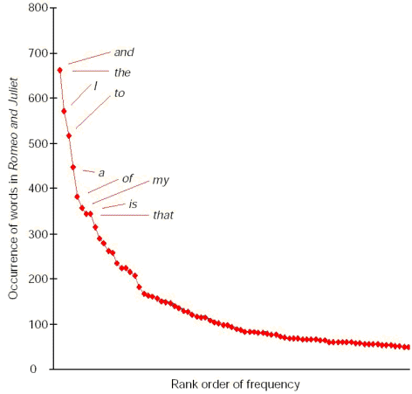
Word Distribution for Romeo & Juliet
The product of the frequency of words and their rank (r) is approximately constant
(up to a certain rank)

Slide 10
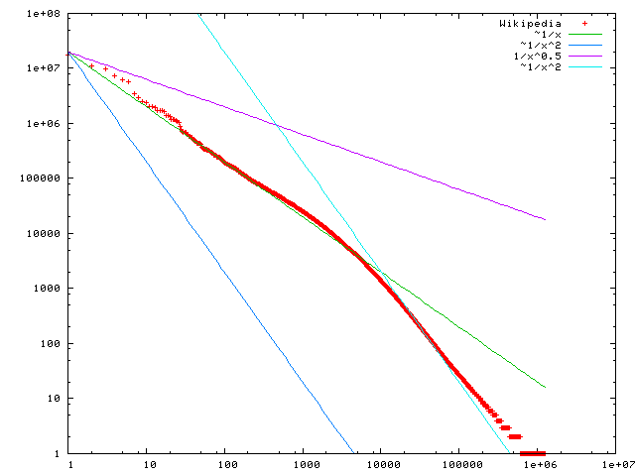
Wikipedia word frequency and rank
on a log-log scale
Frequency
Rank
http://upload.wikimedia.org/wikipedia/commons/b/b9/Wikipedia-n-zipf.png

Slide 11
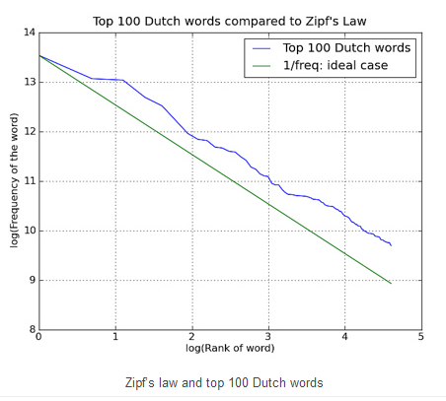

Slide 12
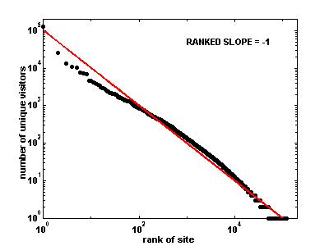
Does Zipf’s Law Fit This Distribution?

Slide 13
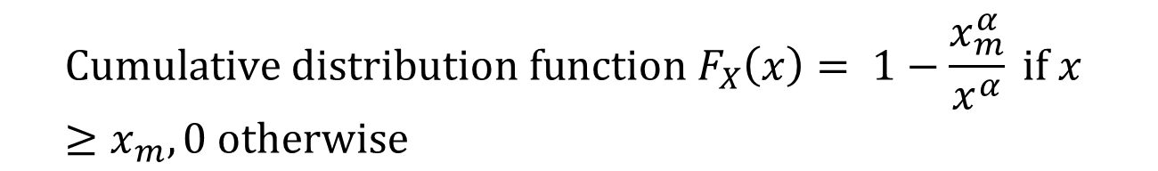
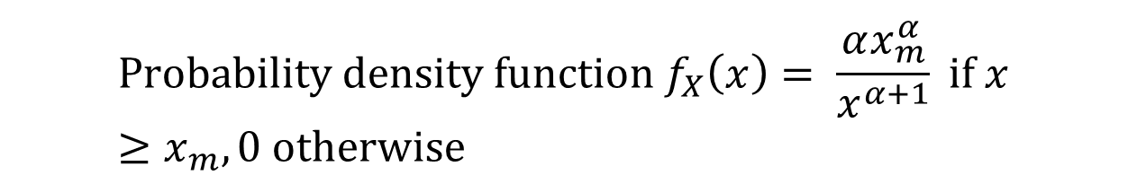
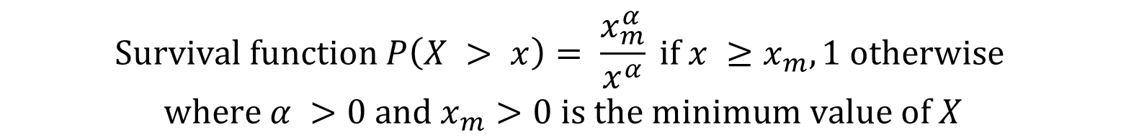
Hello Mr. Pareto!
$$X is a random variable with a Pareto distribution$$
$$Survival function P\left(X > x\right)= \frac{x_{m}^{α}}{x^{α}} if x ≥x_{m}, 1 otherwise$$
$$where α >0 and x_{m}>0 is the minimum value of X$$
$${Cumulative distribution function F}_{X}\left(x\right)= 1−\frac{x_{m}^{α}}{x^{α}} if x ≥x_{m}, 0 otherwise$$
$${Probability density function f}_{X}\left(x\right)= \frac{αx_{m}^{α}}{x^{α+1}} if x ≥x_{m}, 0 otherwise$$

Slide 14

Connection to Pareto’s Law
Pareto’s law: # events > x inversely related to a power of x
P(X > x) x^{-a}
E.g., number of people with income > x
Any correspondence with Zipf’s law?
 | Y-axis | X-axis
Zipf’s law | # occurrences of words | Rank of word
Pareto’s law | # people with income ≥ x | Income x
Source: http://www.hpl.hp.com/research/idl/papers/ranking/ranking.html#ap2

Slide 15
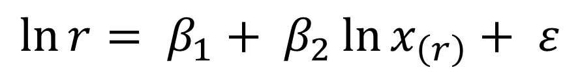
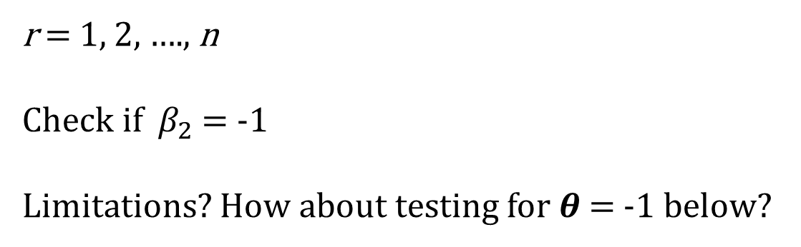
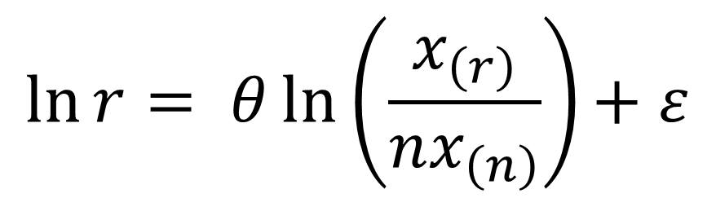
Empirical Testing of Zipf’s Law
$$\ln{r= β_{1}+ β_{2}\ln{x_{\left(r\right)}+ ε}}$$
r = 1, 2, …., n
Check if $β_{2}$= -1
Limitations? How about testing for 𝜽 = -1 below?
$$\ln{r= θln\left(\frac{x_{\left(r\right)}}{nx_{\left(n\right)}}\right){+ ε}}$$
Notes:
X(n) is the frequency of n = #(n)
Limitations:
- The ln(r) = beta1 +beta2*ln(#(r)) + e here The rank ® of a word is discrete iand increases constantly. It’s not uniform

Slide 16
From Unstructured to Structured Data
Represent documents by attributes (e.g., presence or absence of terms)
Can use existing data mining methods on attributes
Vector representation
E.g., bag-of-words
Add some statistical characteristics
E.g., term frequency, document frequency, length, etc.

Slide 17
Document Representation
Binary representation: Presence of absence of terms
 | Terms
 | Digital | Camera | Memory | Pixel | ….
Doc 1 | 1 | 1 | 0 | 1
Doc 2 | 1 | 1 | 1 | 0
….
But a term can occur multiple times in a document
 | Terms
 | Digital | Camera | Memory | Pixel | ….
Doc 1 | 1 | 2 | 0 | 1
Doc 2 | 2 | 3 | 1 | 0
….

Slide 18
Using Relative Frequencies
Use # of occurrences of a term in a document / # terms in the document
 | Terms
 | Digital | Camera | Memory | Pixel | ….
Doc 1 | .01 | .02 | 0 | .01
Doc 2 | .002 | .003 | .001 | 0
….

Slide 19
Classification with Text
Text | Outcome (Class)
Senior position in corporate finance, 20+ years experience preferred | High salary
This restaurant was a waste of time & money. Everything sucks here! | Negative sentiment

Slide 20
But Not All Words Are Created Equal
The main idea (for classification):
Words (or more generally, terms) that appear frequently in a document are …
Words that appear frequently in most documents are ….
Need a metric that shows the importance of a term to a document in a corpus.

Slide 21
Putting it Together
Frequency of jth term in the ith document (call it f_{i,j})
Document frequency of the jth term = what % of documents have the term (say, F_{j})
Term frequency-Inverse document frequency tf-idf = f_{i,j} * log(1/ F_{j})
Term Frequencies | This | is | an | example | equation
Document 1 | 1 | 1 | 1 | 1 | 0
Document 2 | 1 | 1 | 1 | 0 | 1
TF-IDF | This | is | an | example | equation
Document 1 | 1*log(2/2) = 0 | 1*log(2/2) = 0 | 0 | 1*log(2/1) = .3 | 0
Document 2 | 0 | 0 | 0 | 0 | .3

Slide 22
Variations of TF
Log normalized
TF_{ij} = log(1+ f_{ij})
Maximum normalization with damping
Tf_{ij} = a + (1-a)*f_{ij} / max_{i}(f_{ij})
where max_{i}(f_{ij}) is the highest term frequency in document i
0 < a < 1
When would these variations be useful?

Slide 23
Some Issues in Text Classification
The case of sentiment analysis
Need to account for
Negation
E.g., not or n’t followed by a verb can be treated as an additional feature
Parts of speech bigrams (esp. for sentiment analysis)
Trigrams, 4-grams, etc.
The problem of adding extra features
An explosion of |V|
E.g., 25k reviews, 300k basic features, millions of features with bi- & tri-grams
Need to cut down
Thoughts?

Slide 24
But the Vocabulary Becomes Too Large & Redundant
Mutual information of two variables: The amount of information we have about one variable in the presence of the other.
For discrete random variables X & Y:
MI(X;Y) = Ʃ_{xϵX} Ʃ_{yϵY} [p(x,y) * log₂(p(x,y)/(p(x)*p(y)))]
No summation over X for words
Binomial case
x = 0 or 1 (absence or presence of a feature)
y = document class (say, 0, 1)

Slide 25
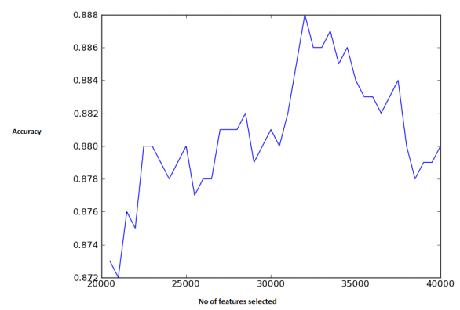
Selecting Features
For each feature, calculate its mutual information (with class)
Plot classification accuracy as a function of the number of features selected, starting with features with highest mutual information
About 32k features with highest MI selected

